Slide 1
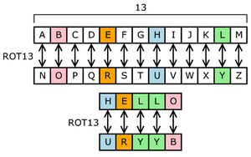
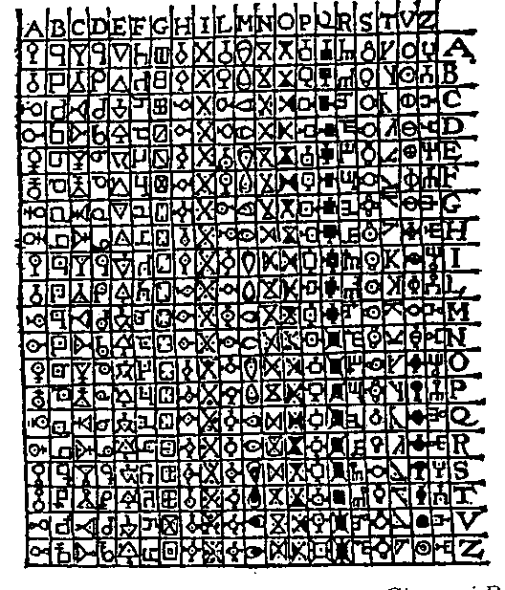

Presentation on Polygraphic substitution

Slide 2
Presented By Md Raju Biswas ASH1925001M Md Nayeem Khan ASH1925027M
Presented To
Falguni Roy Assistant Professor IIT,NSTU

Slide 3
Polygraphic Substitution Definition: Polygraphic substitution is a cipher in which a uniform substitution is performed on blocks of letters. Classification:
Four Square ,Two Square
(Lester H. Hill) Hill Cipher
(In 1854 , charleswheatstone)
Playfair cipher

Slide 4
Playfair Cipher The Playfair cipher was the first practical digraph substitution cipher. The scheme was invented in 1854 by Charles Wheatstone but was named after Lord Playfair who promoted the use of the cipher. :
The Playfair Cipher Encryption Algorithm:
1.Choose a keyword
2.Enter Characters of the keyword in 5*5 matrix row wise 3.Then fill the remaining gaps of the matrix with English alphabet putting I and J in same cell
4.Break the input plaintext in group(pairs) of two alphabets.
5.If both of the alphabets are same or only one is left add an X after 1st one.
6.If the letter of a pair appear in same row replace them the letters to their immediate right respectively .
7. If the letter of a pair appear in same column replace them the letters to their immediate below respectively .
8.If the letter are in different rows and columns, replace the pair with letters in the same row respectively but at other pair of corners.

Slide 5
Example: Plaintext :Memory keyword :MONARCHY
M | O | N | A | R
C | H | Y | B | D
E | F | G | I/J | K
L | P | Q | S | T
U | V | W | X | Z
Plaintext :memory
Pair of the word :me mo ry
CL ON ND
Cipher text :CLONND
**Plaintext :GREET then the pair will be GR EX EX TX

Slide 6

Hill Cipher
>Hill cipher is a substitution cipher based on linear algebra.
>Each letter is represented by a number modulo 26.
>Though this is not an essential feature of the cipher, this simple scheme is often used
>To encrypt a message, each block of n letters is multiplied by an invertible n × n matrix, against modulus 26.
>To decrypt the message, each block is multiplied by the inverse of the matrix used for encryption.
>The matrix used for encryption is the cipher key, and it should be chosen randomly from the set of invertible n × n matrices (modulo 26).

Slide 7


Hill cipher: Encrypting and Decrypting
Key
**C=KP mod 26
Plaintext
**If the Key matrix 2x2 then =2x1
3x3 “ “ =3x1
4x4 “ “ =4x1

Slide 8
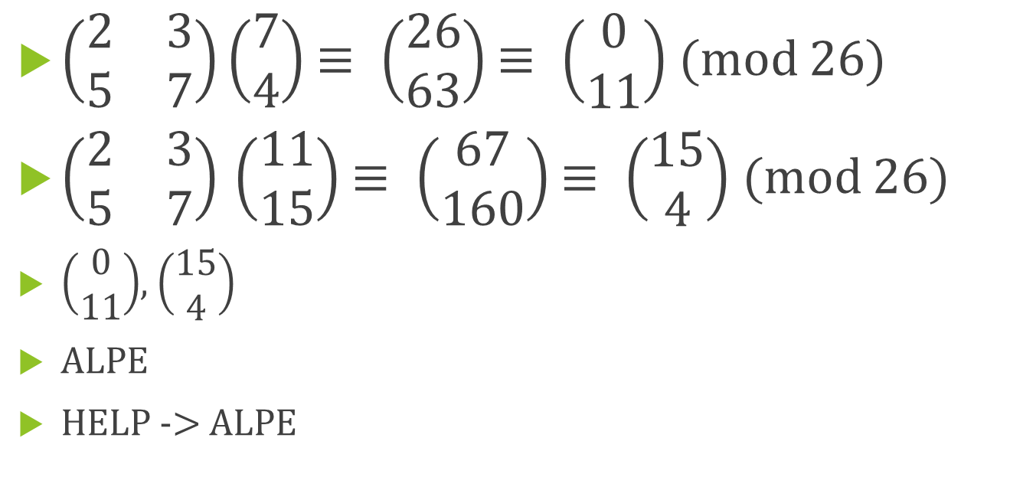
Hill cipher: Encrypting and Decrypting

Slide 9
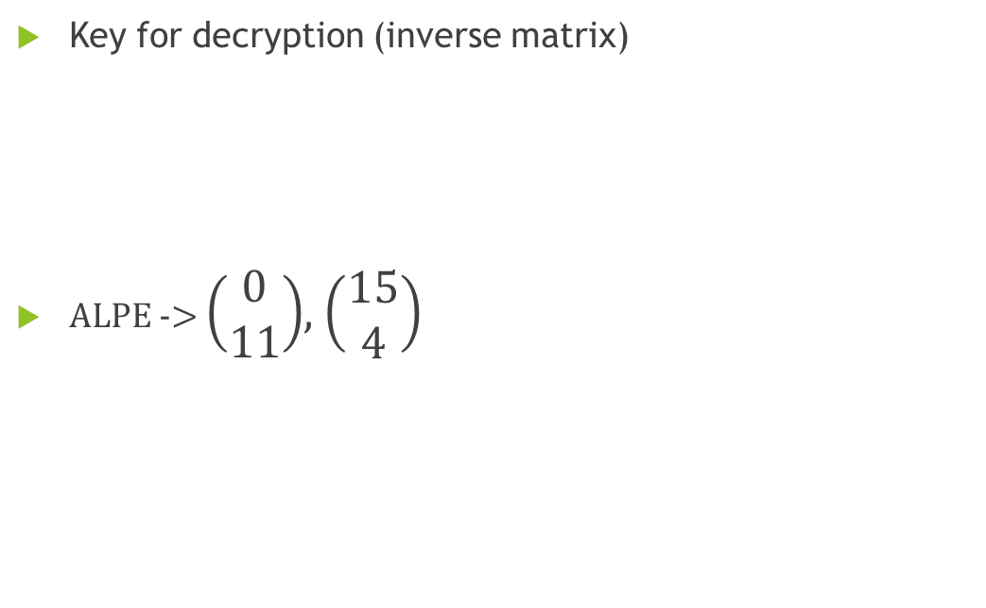

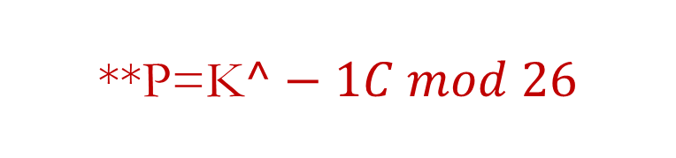
Hill cipher: Encrypting and Decrypting
**P=K$^−1C mod 26$

Slide 10
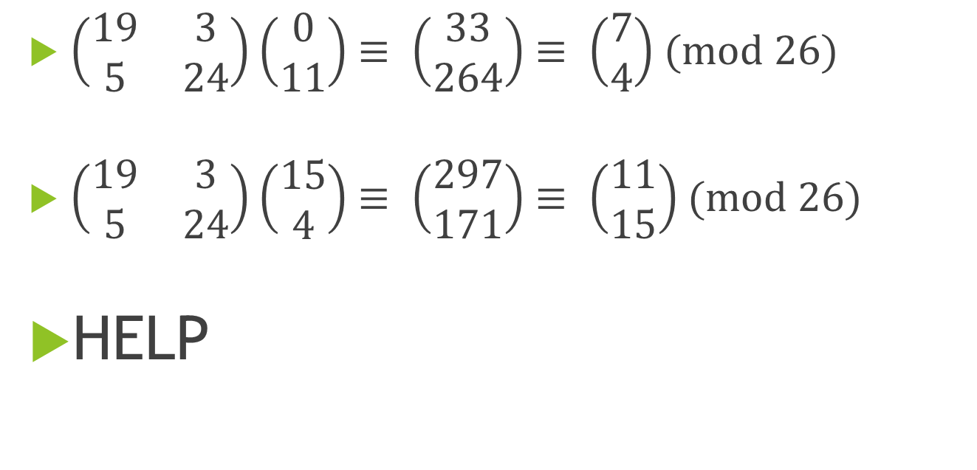
Hill cipher: Encrypting and Decrypting

Slide 11
Four Square
The four-square cipher is a modified version of the Playfair cipher. It provides better security of protected data. It was invented by a French cryptanalyst Félix Delastelle in 19th century.
Usage
It was used by all armies during World War II. Nowadays, it is considered to be easily breakable by using brute force attacks.

Slide 12
The four-square cipher is a polygraphic substitution cipher. Algorithm
The whole plaintext is divided into groups of letters.
Then, each group is replaced by another previously determined group of characters.
Before encryption, it is necessary to prepare four tables.
All the tables have dimensions of 5 by 5 letters and contain 26 letters of alphabets.
There are two type of table plaintext table and cipher table
Each text make a pair then calculate the cipher

Slide 13
Plaintext : HELP ME, Key : Example Keyword Here 1 and 4 are Plaintext table and 2,3 are cipher table Now the pair is HE=fy (r2+c10,r6+c3)
1
2
a | b | c | d | e
f | g | h | i/j | k
l | m | n | o | p
q | r | s | t | u
v | w | x | y | z
E | X | A | M | P
L | B | C | D | F
G | H | I/J | K | N
O | Q | R | S | T
U | V | W | Y | Z
3
K | E | Y | W | O
R | D | A | B | C
F | G | H | I/J | L
M | N | P | Q | S
T | U | V | X | Z
4
a | b | c | d | e
f | g | h | i/j | k
l | m | n | o | p
q | r | s | t | u
v | w | x | y | z

Slide 14
LP=ng(r3+c10, r8+c1)
a | b | c | d | e
f | g | h | i/j | k
l | m | n | o | p
q | r | s | t | u
v | w | x | y | z
E | X | A | M | P
L | B | C | D | F
G | H | I/J | K | N
O | Q | R | S | T
U | V | W | Y | Z
E | X | A | M | P
L | B | C | D | F
G | H | I/J | K | N
O | Q | R | S | T
U | V | W | Y | Z
a | b | c | d | e
f | g | h | i/j | k
l | m | n | o | p
q | r | s | t | u
v | w | x | y | z

Slide 15
ME =nx(r3+c10,r6+c2)
a | b | c | d | e
f | g | h | i/j | k
l | m | n | o | p
q | r | s | t | u
v | w | x | y | z
E | X | A | M | P
L | B | C | D | F
G | H | I/J | K | N
O | Q | R | S | T
U | V | W | Y | Z
E | X | A | M | P
L | B | C | D | F
G | H | I/J | K | N
O | Q | R | S | T
U | V | W | Y | Z
a | b | c | d | e
f | g | h | i/j | k
l | m | n | o | p
q | r | s | t | u
v | w | x | y | z

Slide 16
Cipher text =fyngnx

Slide 17
Advantage The algorithm of the four-square cipher provides better security than the playfair and two square. here are not plaintext letters appearing in the ciphertext, or the reversed plaintext pairs are not encrypted by using the same letters Disadvantage The small disadvantage of the four-square cipher is the fact that it is slightly slower and more difficult to use (when comparing to the two ciphers mentioned above). It happens because there are more tables and secret keys involved in the operations that needs to be remembered.

Slide 18
Two Square Cipher: The Two-Square Cipher is a variant of the Four-Square cipher, intended to be easier to use (and as a result less secure) than the Four-Square cipher, though still more secure than the single-square Playfair cipher. Algorithm 1.First create two key 2.Splide the message into alphabets in the pairs of 2. 3.Form 5 by 5 matrix using two key word and the alphabets. 4.In the both case ,Q is omitted or i and j are in same group. 5.Find the first letter in the digraph in the lower/lest text matrix Find the second letter in the digraph in the upper/right text matrix 6.A rectangle id define by two plaintext character and the opposite corners define the cipher text diagrams 7.When two letters in a diagram fall on the same column/row for either the vertical two square or horizontal two square .this is known as transparency.

Slide 19
First we need to select a message to send Plaintext : TWO SQUARE CIPHER IS AMAZING. Key : MATH CID
Now the making the pair
TW OS QU AR EC IP HE RI SA MA ZI NG
*5 BY 5 matrix is created using key word and alphabet
M | A | T | H | B
C | D | E | F | G
I/J | K | L | N | O
P | Q | R | S | U
V | W | X | Y | Z
C | I/J | D | A | B
E | F | G | H | K
L | M | N | O | P
Q | R | S | T | U
V | W | X | Y | Z

Slide 20
TW OS QU AR EC IP HE RI SA MA ZI NG Now T =X,W=I TW=XI
M | A | T | H | B
C | D | E | F | G
I/J | K | L | N | O
P | Q | R | S | U
V | W | X | Y | Z
C | I/J | D | A | B
E | F | G | H | K
L | M | N | O | P
Q | R | S | T | U
V | W | X | Y | Z

Slide 21
TW OS QU AR EC IP HE RI SA MA ZI NG Here, O=U,S=N OS=UN Same as it is QU=UQ, AR=QI, EC=TE, IP=PI, HE=FC, RI=TR, SA=HT, MA=AM, ZI=BW, NG=FN,
M | A | T | H | B
C | D | E | F | G
I/J | K | L | N | O
P | Q | R | S | U
V | W | X | Y | Z
C | I/J | D | A | B
E | F | G | H | K
L | M | N | O | P
Q | R | S | T | U
V | W | X | Y | Z

Slide 22
.
Thank you.

